Slide 1
Deep Learning Zero Shot Text Classification Model_Assignment2
REVA Academy for Corporate Excellence (RACE)
Anand Mohan
SRN: R19MBA53
MBA in Business Analytics
race.reva.edu.in

Slide 2
Zero Shot Text Classification Model-2
Zero Shot Text Classification Model applied on the “Description” Field to predict the “Genre” Labels of IMDB-Movie-Data Dataset.
zero shot model Link: https://archive.ics.uci.edu/ml/datasets/wine

Slide 3
Zero Shot Text Classification Model-2
zero-shot sequence classifiers:
Yin et al. proposed a method for using pre-trained NLI models as a ready-made zero-shot sequence classifiers. The method works by posing the sequence to be classified as the NLI premise and to construct a hypothesis from each candidate label.

Slide 4
Zero Shot Text Classification Model-2
zero-shot classification method:
It is surprisingly effective in many cases, particularly when used with larger pre-trained models like BART and Roberta. Here, we are using this model for zero-shot classification with Hugging Face's built-in pipeline.

Slide 5
Zero Shot Text Classification Model-2
Applying Zero Shot Text Classification Model on IMDB-Movie-Data Dataset:
we will collect first 100 rows of IMDB-Movie-Data Dataset and use Zero Shot Text Classification Model on the “Description” Field to predict the “Genre” Labels.

Slide 6
Zero Shot Text Classification Model-2
predicting the “Genre” Labels:
After Applying Zero Shot Text Classification Model on the “Description” Field of first 100 rows of IMDB-Movie-Data Dataset ,the “Genre” Labels are predicted and stored in the text file as attached below.

Slide 7
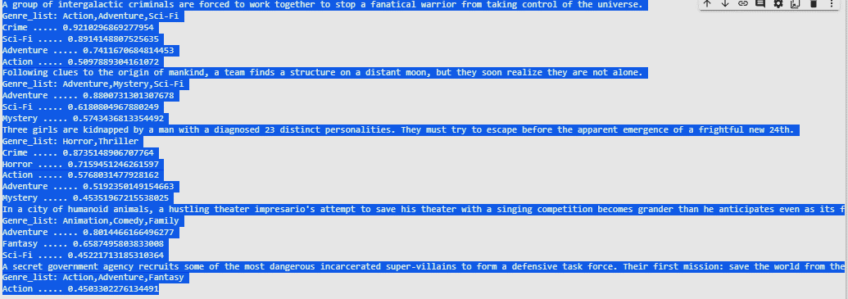
Zero Shot Text Classification Model-2
Evaluating prediction probabilities for the first five sequences:
predicting the “Genre” Labels, we are listing all scores of different labels for first five sequences and comparing with what is available in Genre_list. we get prediction probabilities of quite many labels as higher than 45% and mostly in the range of 70-90% which is quite satisfactory.

Slide 8


